Slide 1

PReference
A Personal Reference tool built with AngularJS
Keep track of your:
apps
demos
tutorials
resources
frameworks
conventions

Slide 2

Learning AngularJS

Slide 3

Lots of vocabulary, syntax, concepts
App
Module
Controller
Scope
Directives
Views
Animation
Routes
Factories
Services
Data binding
Templates
ng-app
ng-click
ng-model
ng-view
{{ something }}
JSON
dependency injection
REST-like API’s
.js
iff
promises
chaining

Slide 4
[not so] simple overview diagrams

Slide 5

looks chaotic at first - but it can be seen simplified and orderly

Slide 6


a little bit of grouping and study…

Slide 7

So relax…
It’s demo time!

Slide 8

Intro demo
//index.html
<!doctype html>
<html ng-app="introApp">
<head>
<title>Resources</title>
<link href="foundation.css" rel="stylesheet" />
</head>
<body>
...
<script src="angular.js"></script>
<script src="main.js"></script>
</body>
</html>
//main.js
var myApp = angular.module('introApp', []);

Slide 9

//index.html
<h1>{{2+2}}</h1>
<h1>{{"Raleigh" + "Code" + "Camp" + "14"}}</h1>
<input type="text" ng-model="data.message" />
<h1>{{data.message}}</h1>
<h1>{{data.message + " world"}}</h1>
<div class="{{data.message}}">
wrap me with a panel
</div>

Slide 10

Add a controller
//main.js
function FirstCtrl($scope) {
$scope.data = { message: "panel" }
}
//index.html
<div ng-controller="FirstCtrl">
<input type="text" ng-model="data.message" />
<h1>{{data.message + " world"}}</h1>
<div class="{{data.message}}">
Please wrap me in a panel.
</div>
</div>

Slide 11

Creating a factory
Adding a method to the controller
Passing parameters into the method
//main.js
myApp.factory('Data', function () {
return { message: "I'm data from a service" }
});
function FirstCtrl($scope, Data) {
$scope.data = Data;
}
function SecondCtrl($scope, Data) {
$scope.data = Data;
$scope.reversedMessage = function () {
return $scope.data.message.split("").reverse().join("");
}
}
function ThirdCtrl($scope, Data) {
$scope.data = Data;
$scope.reversedMessage = function (message) {
//remove the dependency on passing along scope
return message.split("").reverse().join("");
}
}
//index.html
<div ng-controller="FirstCtrl">
<input type="text" ng-model="data.message" />
<h1>{{data.message}}</h1>
</div>
<div ng-controller="SecondCtrl">
<input type="text" ng-model="data.message" />
<h1>{{reversedMessage()}}</h1>
</div>
<div ng-controller="ThirdCtrl">
<input type="text" ng-model="data.message" />
<h1>{{reversedMessage(data.message)}}</h1>
</div>

Slide 12

Tying a View and Controller together
//index.html
<div ng-controller="ResourcesCtrl">
<table class="table">
<tr>
...
</tr>
<tr ng-repeat="resource in resources" >
<td>{{ resource.title}}</td>
...
</tr>
</table>
</div>
//main.js
myApp.factory('Resources', function () {
var Resources = {};
//json data
Resources = [
{ id: 1, title: '60ish Minutes', author: 'Dan Wahlin', url: 'http:www.blahblah.com', type: 'video', summary: 'The summary goes here...' },
{ id: 2, title: 'Angular', author: 'Lukas Ruebbelke', url: 'https://egghead.io/series/angularjs-app', type: 'blog', summary: 'The summary goes here...' },
...
];
return Resources;
});
function ResourcesCtrl($scope, Resources) {
$scope.resources = Resources;
}

Slide 13
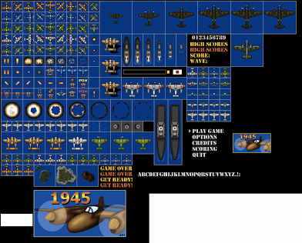
Iterating with the ng-repeat Directive
//index.html
<div ng-controller="ResourcesCtrl">
<table class="table">
<tr>
<th>Title</th>
<th>Url</th>
<th>Author</th>
<th>Type</th>
<th>Summary</th>
</tr>
<tr ng-repeat="resource in resources" >
<td>{{ resource.title}}</td>
<td>{{ resource.url }}</td>
<td>{{ resource.author }}</td>
<td>{{ resource.type}}</td>
<td>{{ resource.summary}}</td>
</tr>
</table>
<br />
<span>Number of Resources: {{ resources.length }}</span>
<br />
</div>

Slide 14
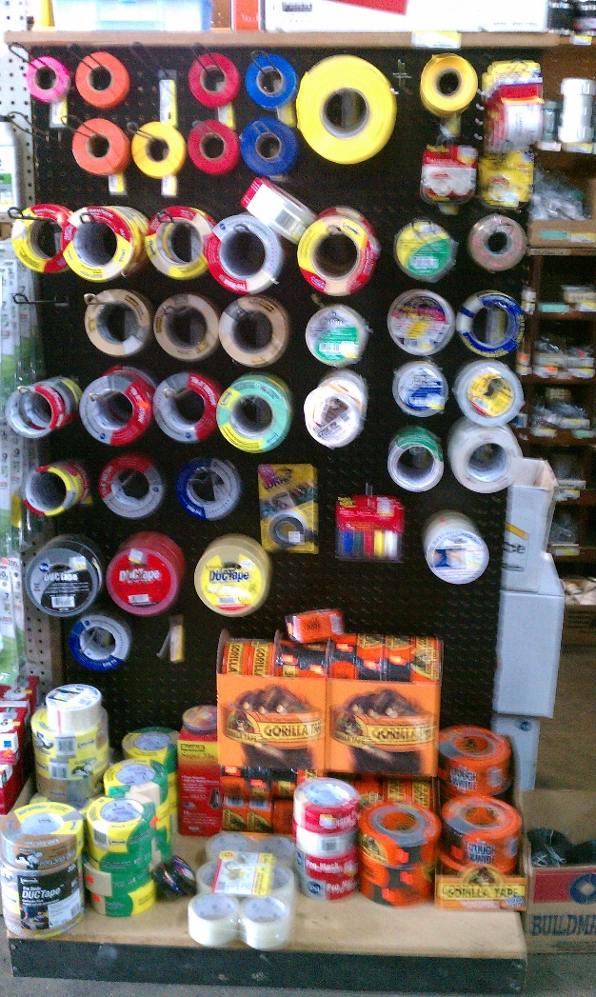
Sorting and Formatting Data
//index.html
<div ng-controller="ResourcesCtrl">
<table class="table">
<tr>
<th>Title</th>
<th>Url</th>
<th>Author</th>
<th>Type</th>
<th>Summary</th>
</tr>
<tr ng-repeat="resource in resources | orderBy:'title' " >
<td>{{ resource.title}}</td>
<td>{{ resource.url }}</td>
<td>{{ resource.author }}</td>
<td>{{ resource.type | uppercase}}</td>
<td>{{ resource.summary}}</td>
</tr>
</table>
</div>

Slide 15

Filtering Data
<div>
Title Filter: <input type="text" ng-model="resourcesFilter.title"/>
</div>
<div>
Author Filter: <input type="text" ng-model="resourcesFilter.author" />
</div>
<div>
All columns Filter: <input type="text" ng-model="resourcesFilter.$" />
</div>
<div ng-controller="ResourcesCtrl">
<table class="table">
<tr>
<th>Title</th>
<th>Url</th>
<th>Author</th>
<th>Type</th>
<th>Summary</th>
</tr>
<tr ng-repeat="resource in resources | filter:resourcesFilter | orderBy:'title' " >
<td>{{ resource.title}}</td>
<td>{{ resource.url }}</td>
<td>{{ resource.author }}</td>
<td>{{ resource.type | uppercase }}</td>
<td>{{ resource.summary }}</td>
</tr>
</table>
</div>

Slide 17

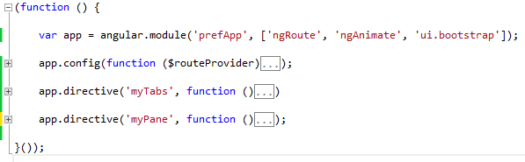
//app.js
//index.html
<html data-ng-app="prefApp">

Slide 18

//articlesFactory.js
var articlesFactory = function ($http) {
var factory = {};
//articles
factory.getArticles = function () {
// just return the promise, let controller handle errors and process data
return $http.get('/articles');
};
factory.getArticle = function (articleId) {}
factory.deleteArticle = function (articleId) {}
//resources
factory.getResources = function () {}
return factory;
};
articlesFactory.$inject = ['$http'];
angular.module('prefApp').factory('articlesFactory', articlesFactory);
}());

Slide 19


Slide 20

//values.js
angular.module('prefApp').value('appSettings', {
title: 'PReference Application',
});
// constant() is available in the config()
// value() is not
angular.module('prefApp').constant('appSettings', {
version: '1.0'
});
//allarticles.html
<h2>{{ appSettings.title }}</h2>
...
<footer>
Version: {{ appSettings.version }}
</footer>

Slide 21


Getting Data from a REST-like API
accessing the $http Response Data
relies on $q service’s deferred/promise APIs
access data by calling then() or success()/error()
using the $http Service
//ArticlesController.js
(function () {
function ArticlesController($scope, $log, $window, articlesFactory, appSettings) {
...
function init() {
articlesFactory.getArticles()
.success(function (articles) {
$scope.articles = articles;
})
.error(function (data, status, headers, config) {
$log.log(data.error + ' ' + status);
});
}
init();
...
};
ArticlesController.$inject = ['$scope', '$log', '$window', 'articlesFactory', 'appSettings'];
angular.module('prefApp').controller('ArticlesController', ArticlesController);
}());
//articlesFactory.js
var articlesFactory = function ($http) {
var factory = {};
//articles
factory.getArticles = function () {
// just return the promise, let controller handle errors and process data
return $http.get('/articles');
};
...
return factory;
};
articlesFactory.$inject = ['$http'];
angular.module('prefApp').factory('articlesFactory', articlesFactory);
}());

Slide 22

//ArticlesController.js
(function () {
function ArticlesController($scope, $log, $window, articlesFactory, appSettings) {
$scope.sortBy = 'name';
$scope.reverse = false;
$scope.articles = [];
$scope.appSettings = appSettings;
function init() {
articlesFactory.getArticles()
.success(function (articles) {
$scope.articles = articles;
})
.error(function (data, status, headers, config) {
$log.log(data.error + ' ' + status);
});
}
init();
$scope.doSort = function (propName) {
$scope.sortBy = propName;
$scope.reverse = !$scope.reverse;
};
$scope.deleteArticle = function (articleId) {};
};
ArticlesController.$inject = ['$scope', '$log', '$window', 'articlesFactory', 'appSettings'];
angular.module('prefApp').controller('ArticlesController', ArticlesController);
}());

Slide 23

Dealing with minification - $inject - using the ‘single quotes‘
//articlesFactory.js
var articlesFactory = function ($http) {
var factory = {};
//articles
factory.getArticles = function () {
// just return the promise, let controller handle errors and process data
return $http.get('/articles');
};
...
};
articlesFactory.$inject = ['$http'];
angular.module('prefApp').factory('articlesFactory', articlesFactory);
}());
//ArticlesController.js
(function () {
function ArticlesController($scope, $log, $window, articlesFactory, appSettings) {
...
};
ArticlesController.$inject = ['$scope', '$log', '$window', 'articlesFactory', 'appSettings'];
angular.module('prefApp').controller('ArticlesController', ArticlesController);
}());

Slide 24

//articleController.js
function ArticleController($scope, $routeParams, articlesFactory) {
var articleId = $routeParams.articleId;
$scope.article = null;
function init() {
articlesFactory.getArticle(articleId)
.success(function (article) {
$scope.article = article;
})
//article.html
<h2>{{ article.title }}</h2>
<span>{{ article.summary }}</span>
<my-tabs>
<!--Main-->
<my-pane title="Main">
<div id="MainTab">
<br />
<div id="ArticleContent" style="width:90%; float:left;">
<table class="table table-bordered">
<tr>
<td colspan="2" height="500px"> {{article.content}} </td>
</tr>
</table>
</div>
</div>
</my-pane>

Slide 25

ng-view
//index.html
<html data-ng-app="prefApp">
<head>
<title>Iterating Over Data</title>
<link href="styles/styles.css" rel="stylesheet" type="text/css" />
<link href="styles/bootstrap.min.css" rel="stylesheet" type="text/css" />
<link href="styles/animations.css" rel="stylesheet" type="text/css" />
</head>
<body>
<header>
<nav class="navbar navbar-default">
<ul class="nav navbar-nav">
<li><a href="#/articles">Articles</a></li>
<li><a href="#/resources">Resources</a></li>
</ul>
</nav>
</header>
<main>
<div ng-view class="slide-animation" style="margin:10px;"></div>
</main>
<script src="scripts/angular.js"></script>

Slide 26


Slide 27

//app.js
(function () {
var app = angular.module('prefApp', ['ngRoute', 'ngAnimate', 'ui.bootstrap']);
app.config(function ($routeProvider) {
$routeProvider
.when('/', {
controller: 'ArticlesController',
templateUrl: 'app/views/allarticles.html'
})
.when('/articles/:articleId', {
controller: 'ArticleController',
templateUrl: 'app/views/article.html'
})
.when('/resources/:articleId', {
controller: 'ResourcesController',
templateUrl: 'app/views/resources.html'
})
.when('/resources', {
controller: 'AllResourcesController',
templateUrl: 'app/views/allresources.html'
})
.otherwise({ redirectTo: '/' });
});

Slide 28

//app.js
(function () {
var app = angular.module('prefApp', ['ngRoute', 'ngAnimate', 'ui.bootstrap']);
app.config(function ($routeProvider) {
$routeProvider
.when('/', {
controller: 'ArticlesController',
templateUrl: 'app/views/allarticles.html'
})
.when('/articles/:articleId', {
controller: 'ArticleController',
templateUrl: 'app/views/article.html'
})
.when('/resources/:articleId', {
controller: 'ResourcesController',
templateUrl: 'app/views/resources.html'
})
.when('/resources', {
controller: 'AllResourcesController',
templateUrl: 'app/views/allresources.html'
})
.otherwise({ redirectTo: '/' });
});

Slide 29


Slide 30


Slide 32


Slide 33


Questions?

Slide 34
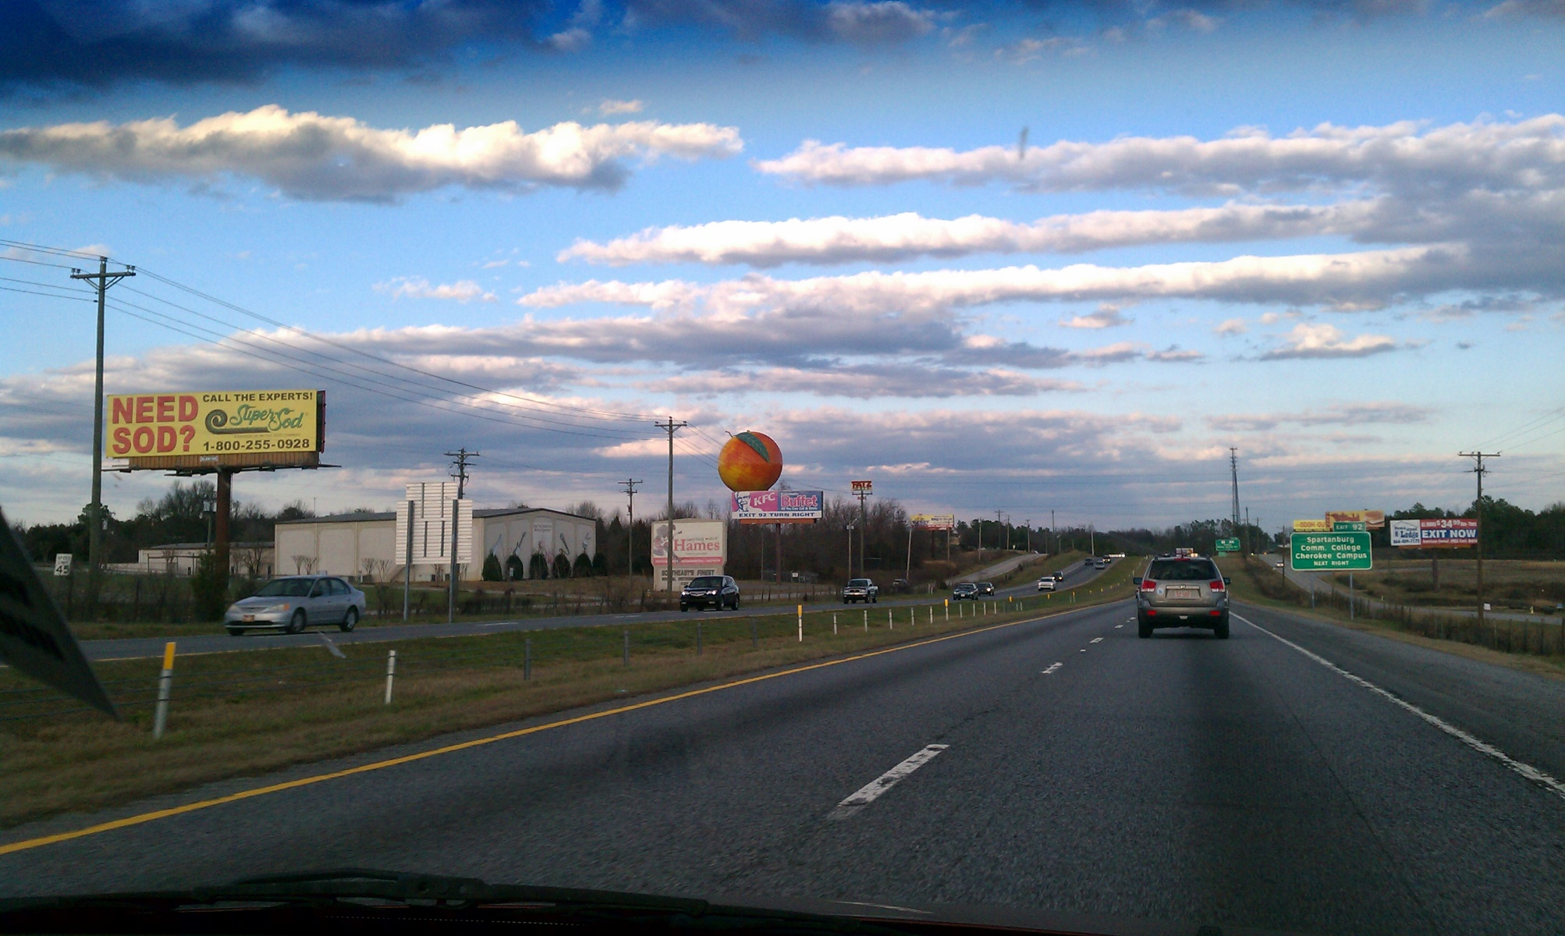

Slide 35


Slide 36


Slide 37

The End

